Slide 1
CS174A Lecture 11

Slide 2
Announcements & Reminders
2/25/24: A3 due; will be discussed during this week’s TA session
3/03/24: A4 due
Team Project Timelines:
2/28/24: project proposals & teams due
3/01/24: midway demo, during regular lecture session, on zoom
3/13/24: final proposals due
3/15/24: final demos
3/19/24: Final exam, 6:30-8:30 PM, in person, location TBD
Study guide and book exercises posted

Slide 3
TA Session This Friday
A3
Team project proposals & midway demos
Peerceptiv peer-evaluation pipeline
Examples of HSR and Illumination

Slide 4
Last Lecture Recap
Hidden Surface Removal
Painter’s algorithm
Z-buffer algorithm
Scanline z-buffer algorithm
Properties, advantages, disadvantages of each
Efficiency considerations

Slide 5
Next Up
Lighting/Illumination Models
Ambient
Diffuse
Specular
Flat and Smooth Shading
Barycentric Coordinates, Bilinear Interpolations
Shadow Algorithms
2-pass z-buffer algorithm
Hidden Surface Removal
Ray casting

Slide 6
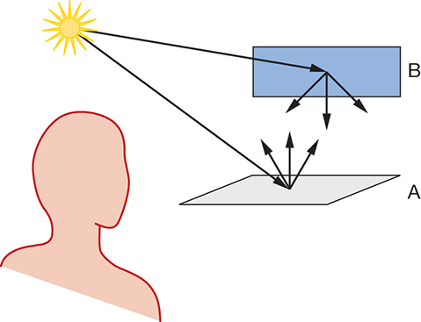
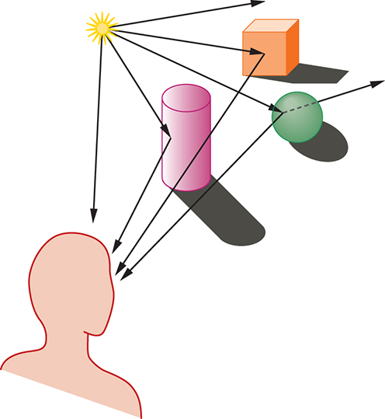
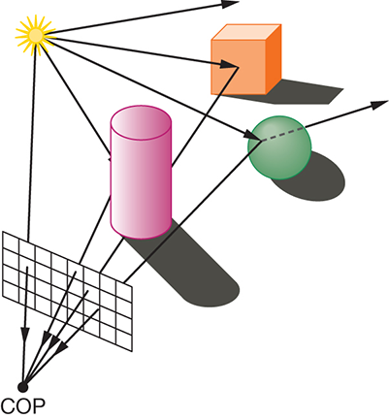
Global Illumination

Slide 7
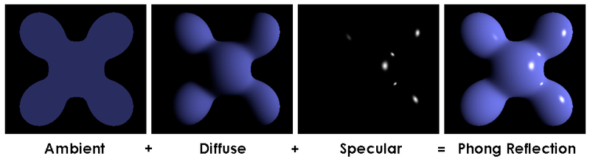
Lighting/Illumination
Types of Lighting
Ambient
Diffuse
Specular

Slide 8
Lighting/Illumination
Geometric Properties
Object: position, orientation (normal)
Light: position, direction, point vs. spot vs. area
Eye: position, orientation
Material Properties
Object: color, reflectivity, shininess, bumpiness, translucency
Light: color
Eye: filter, color blindness

Slide 9
Ambient Lighting
Properties
Background light
Unrealistic
Works as a good approximation of scattered light
Does NOT depend on position/orientation of light, object or eye
Only depends on object and light’s material property
k_{a} = ambient reflection coefficient, values [0..1], may be different for R, G, B
I_{a} = intensity of ambient light source, values [0..1], different for R, G, B
Ambient light reflected off object = k_{a} * I_{a}

Slide 10
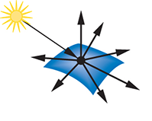
Diffuse Lighting
Properties
Point light source
Lambertian (or diffuse) reflection for dull, matte surfaces
Surfaces look equally bright from all directions
Reflect light equally in all directions
Lambert’s Law: amount of light reflected from a differential unit area dA toward a viewer is ∝ the cosine of the angle between the incident light and the normal (θ)
k_{d} = diffuse reflection coefficient, values [0..1]
I_{p} = intensity of point light source, values [0..1]
Diffuse light reflected off object = k_{d} * I_{p} * cosθ = k_{d} * I_{p} * (N·L)

Slide 11
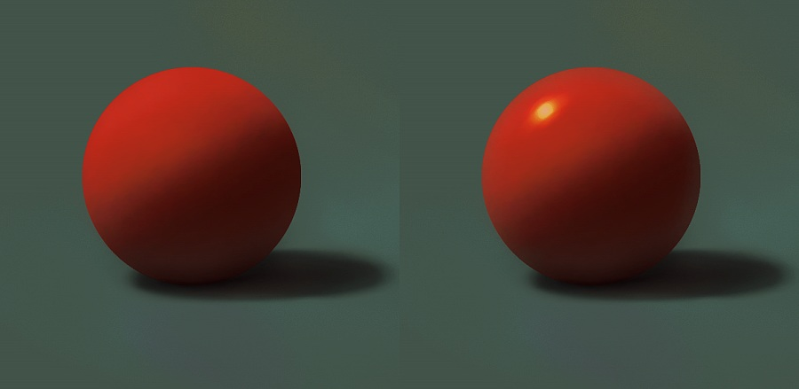
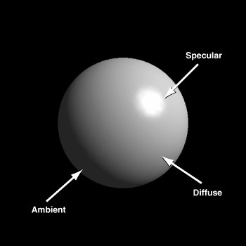
Specular Lighting
Properties
Shiny surfaces
Color of light, not object
Does depend on position of light, object and eye
Light reflects unequally in different directions (e.g., perfect reflector: mirror)
For non-perfect reflectors
k_{s} = specular reflection coefficient, values [0..1], may be different for R, G, B
n = material’s specular reflection exponent, values [1..100s], perfect reflector n = ∞
Specular light reflected off object = f_{att} * k_{s} * I_{p} * cos^{n}φ = f_{att} * k_{s} * I_{p} * (R·V)^{n}
I_{λ} = k_{aλ} * I_{aλ} * O_{dλ} + f_{att} * k_{dλ} * I_{pλ} * (N·L) * O_{dλ} + f_{att} * k_{sλ} * I_{pλ} * (R·V)^{n}

Slide 12
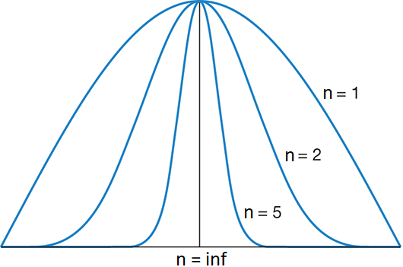
Specular Lighting (Contd.)
Specular Term: Smoothness Exponent Effect
Exponentiating a term that has values < 1 draws it closer to 0
Higher exponent ⇒ smaller region where point light’s reflection is considered aligned with the viewer ⇒ smaller shiny spot
-ve values of cosφ is clamped to 0 = max(0, (R·V)^{n})
Max specular reflection when φ = 0

Slide 13
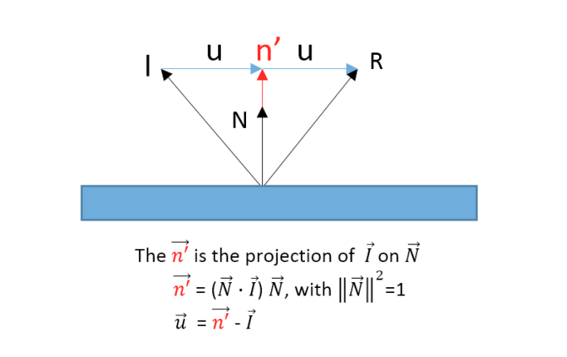
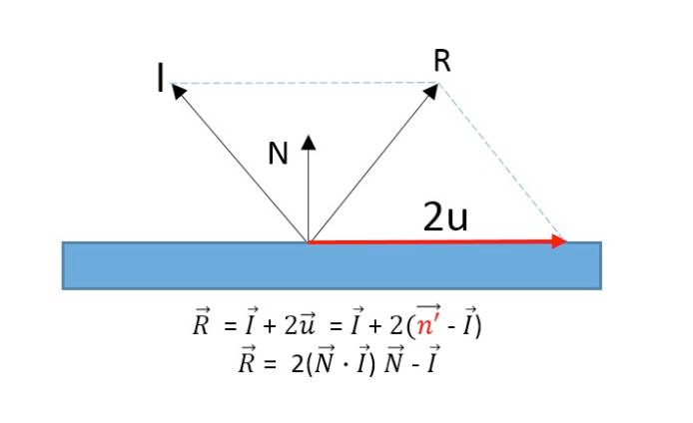
Specular Lighting (Contd.)
Calculating R Vector: reflection of point light source

Slide 14
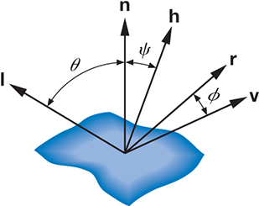
Specular Lighting (Contd.)
Halfway Vector: Alternate Formulation of R·V
Halfway vector (H) between L and V = normalize(L + V)
Replace (R·V)^{n} with (H·N)^{n} = cos^{n}ψ (ψ = ф/2)
This alternate is referred to as Blinn-Phong illumination

Slide 15
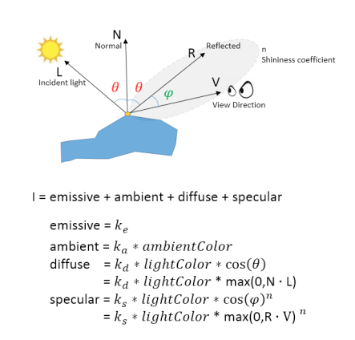
Final Light Equation

Slide 16
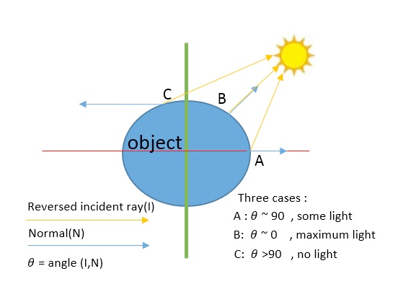
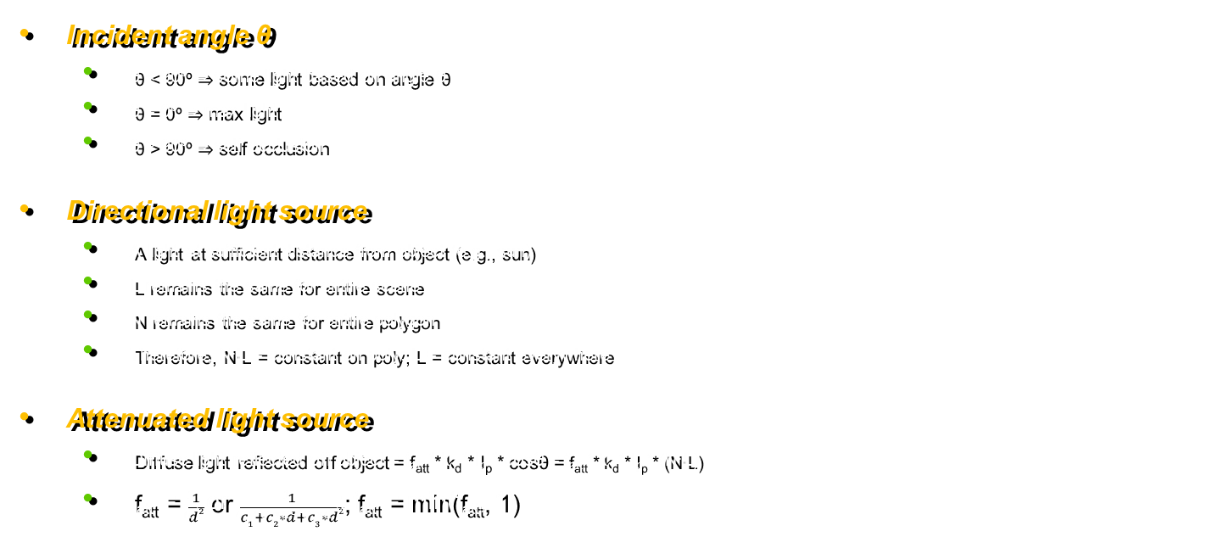
Lighting: Misc Improvements
Incident angle θ
θ < 90º ⇒ some light based on angle θ
θ = 0º ⇒ max light
θ > 90º ⇒ self occlusion
Directional light source
A light at sufficient distance from object (e.g., sun)
L remains the same for entire scene
N remains the same for entire polygon
Therefore, N·L = constant on poly; L = constant everywhere
Attenuated light source
Diffuse light reflected off object = f_{att} * k_{d} * I_{p} * cosθ = f_{att} * k_{d} * I_{p} * (N·L)
f_{att} = $\frac{1}{d2}$ or $\frac{1}{c1+c2∗d+c3∗d2}$; f_{att} = min(f_{att}, 1)

Slide 17
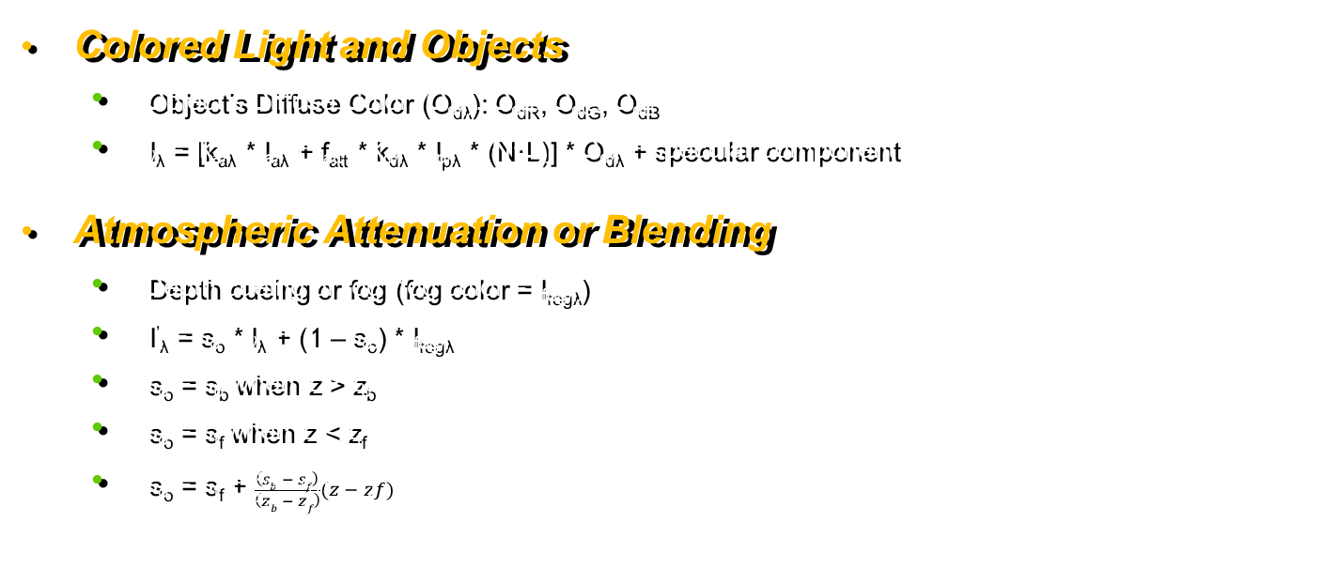
Lighting: Misc Improvements
Colored Light and Objects
Object’s Diffuse Color (O_{dλ}): O_{dR}, O_{dG}, O_{dB}
I_{λ} = [k_{aλ} * I_{aλ} + f_{att} * k_{dλ} * I_{pλ} * (N·L)] * O_{dλ} + specular component
Atmospheric Attenuation or Blending
Depth cueing or fog (fog color = I_{fogλ})
I’_{λ} = s_{o} * I_{λ} + (1 – s_{o}) * I_{fogλ}
s_{o} = s_{b} when z > z_{b}
s_{o} = s_{f} when z < z_{f}
s_{o} = s_{f} + $\frac{\left(sb − sf\right)}{\left(zb − zf\right)}(z − zf)$

Slide 18
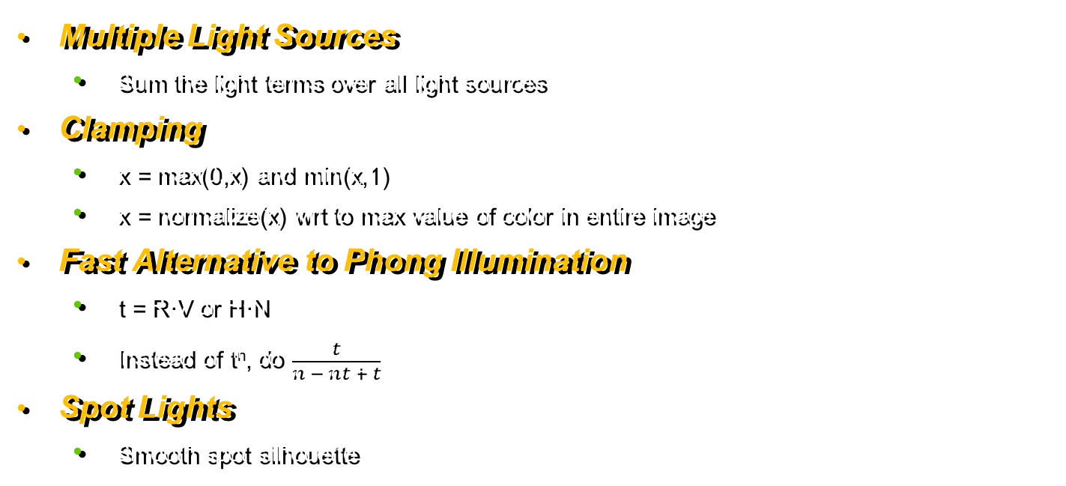
Lighting: Misc Improvements
Multiple Light Sources
Sum the light terms over all light sources
Clamping
x = max(0,x) and min(x,1)
x = normalize(x) wrt to max value of color in entire image
Fast Alternative to Phong Illumination
t = R·V or H·N
Instead of t^{n}, do $\frac{t}{n − nt + t}$
Spot Lights
Smooth spot silhouette

Slide 19
Type of Lights: Summary
Type | Location | Direction
Ambient | No | No
Point | Yes | No
Directional | No | Yes
Spot | Yes | Yes + Spot Angle

